Slide 1

Real-time twitter map
Notes:
Aims -> Means -> Workflow -> Results -> Discussion

Slide 2


Aims
Locate events
location-related trending (#) topics
User-adjustability:
Bounding box to mine tweets from
Lookback time to mine tweets from
Buffer around tweet in which to seek coinciding tweets
Provide general statistical insight
Real-time streaming
Notes:
Locate events
location-related trending (#) topics
User-adjustability:
Bounding box to mine tweets from
Lookback time to mine tweets from
Buffer around tweet in which to seek coinciding tweets
Provide general statistical insight
Real-time streaming

Slide 3

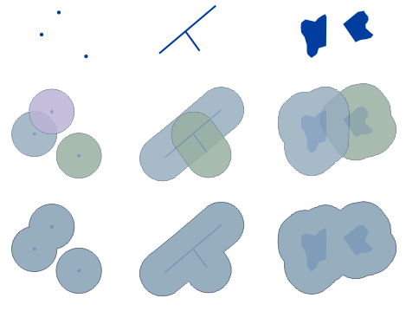
Aims
Locate events
location-related trending (#) topics
User-adjustability:
Bounding box to mine tweets from
Lookback time to mine tweets from
Buffer around tweet in which to seek coinciding tweets
Provide general statistical insight
Real-time streaming
Notes:
Locate events
location-related trending (#) topics
User-adjustability:
Bounding box to mine tweets from
Lookback time to mine tweets from
Buffer around tweet in which to seek coinciding tweets
Provide general statistical insight
Real-time streaming

Slide 4

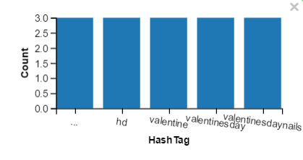
Aims
Locate events
location-related trending (#) topics
User-adjustability:
Bounding box to mine tweets from
Lookback time to mine tweets from
Buffer around tweet in which to seek coinciding tweets
Provide general statistical insight
Real-time streaming
Notes:
Locate events
location-related trending (#) topics
User-adjustability:
Bounding box to mine tweets from
Lookback time to mine tweets from
Buffer around tweet in which to seek coinciding tweets
Provide general statistical insight
Real-time streaming

Slide 5

Notes:
Python (as aftermath of final practical)
R would’ve been possible too! OR both in Bash
Twython for mining, GeoPandas for storing
PostGIS database
GeoServer to launch database online
OSM basemap

Slide 6

Notes:
Python (as aftermath of final practical)
R would’ve been possible too! OR both in Bash
Twython for mining, GeoPandas for storing
PostGIS database
GeoServer to launch database online
OSM basemap

Slide 7

Notes:
Python (as aftermath of final practical)
R would’ve been possible too! OR both in Bash
Twython for mining, GeoPandas for storing
PostGIS database
GeoServer to launch database online
OSM basemap

Slide 8

Notes:
Python (as aftermath of final practical)
R would’ve been possible too! OR both in Bash
Twython for mining, GeoPandas for storing
PostGIS database
GeoServer to launch database online
OSM basemap

Slide 9

Notes:
Python (as aftermath of final practical)
R would’ve been possible too! OR both in Bash
Twython for mining, GeoPandas for storing
PostGIS database
GeoServer to launch database online
OSM basemap

Slide 10

Notes:
Not succeeded to connect GeoServer (Owslib connection) to OSM: attempt to get own
Mapnik wouldn’t work, Osm2psql did (yet only for small extend)!
OSM basemap both too big for VM and too complicated
Attempt to snap London; realization it would ruin the purpose of GeoServer
Folium to use worldwide OSM basemap: use of popups
Shapely too complicated union of buffers; Ogr not in folium; Bokeh too complicated; Vincent tough grammar but worked!
Truncated tweets from GeoPandas (countless RegEx’s)!
Buffer distances from lat-lon to meters

Slide 11
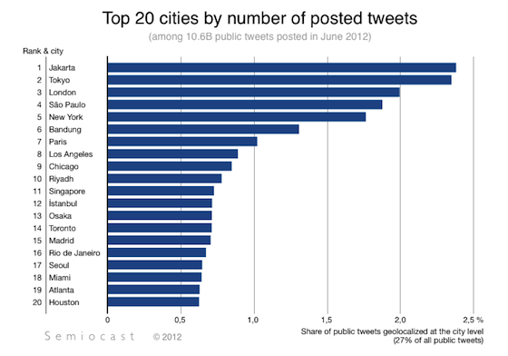
Notes:
Not succeeded to connect GeoServer (Owslib connection) to OSM: attempt to get own
Mapnik wouldn’t work, Osm2psql did (yet only for small extend)!
OSM basemap both too big for VM and too complicated
Attempt to snap London; realization it would ruin the purpose of GeoServer
Folium to use worldwide OSM basemap: use of popups
Shapely too complicated union of buffers; Ogr not in folium; Bokeh too complicated; Vincent tough grammar but worked!
Truncated tweets from GeoPandas (countless RegEx’s)!
Buffer distances from lat-lon to meters

Slide 12

Notes:
Not succeeded to connect GeoServer (Owslib connection) to OSM: attempt to get own
Mapnik wouldn’t work, Osm2psql did (yet only for small extend)!
OSM basemap both too big for VM and too complicated
Attempt to snap London; realization it would ruin the purpose of GeoServer
Folium to use worldwide OSM basemap: use of popups
Shapely too complicated union of buffers; Ogr not in folium; Bokeh too complicated; Vincent tough grammar but worked!
Truncated tweets from GeoPandas (countless RegEx’s)!
Buffer distances from lat-lon to meters

Slide 13
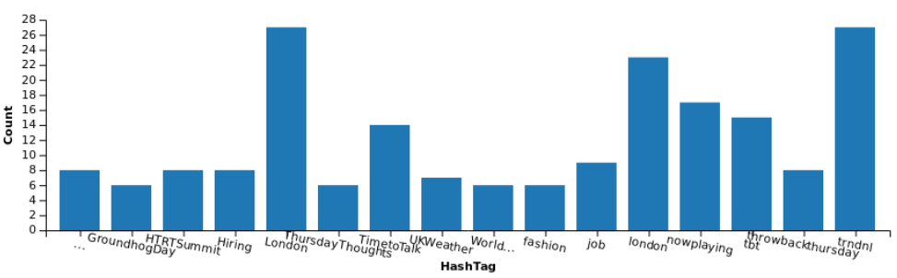
Overall #’s in London, for 2 hours, appearing more than 5 times

Slide 14



Slide 15
Discussion
Bounding box always a sample:
“garden hose instead of a firehose”
Truncation of tweets
Real-time impossible in “time-loop”
1 infinite running ‘ mining’ script + 1 manually called script to plot (/refresh)
Real-time streaming costs money too (e.g. Boundlessgeo)

Slide 16
Discussion
#Lond…
Bounding box always a sample:
“garden hose instead of a firehose”
Truncation of tweets
Real-time impossible in “time-loop”
1 infinite running ‘ mining’ script + 1 manually called script to plot (/refresh)
Real-time streaming costs money too (e.g. Boundlessgeo)

Slide 17

Discussion
#Lond…
Bounding box always a sample:
“garden hose instead of a firehose”
Truncation of tweets
Real-time impossible in “time-loop”
1 infinite running ‘ mining’ script + 1 manually called script to plot (/refresh)
Real-time streaming costs money too (e.g. Boundlessgeo)

